Slide 1

COMPUTER NETWORKS
(BCSC 0008)
Copyright content, use only with the written permission of presenter mentioned
Lecture 21

Slide 2
Text and Reference Books
Text Books:
Fourouzan B. A. (2004), “Data Communication and Networking”, 4th Edition, McGraw-Hill.
References:
Kurose, J. F. and Ross K. W. (2005), “Computer Networking: A Top-Down Approach Featuring the Internet”, 3rd Edition, Addison-Wesley.
A. S. Tanenbaum (2006), “Computer Networks”, 2nd Edition, Prentice Hall India.

Slide 3
3.4 Connecting Devices
LANs or WANs do not normally operate in isolation. They are connected to one another or to the Internet. To connect LANs or WANs, we use connecting devices. Connecting devices can operate in different layers of the Internet model. We discuss three kinds of connecting devices: repeaters (or hubs), bridges (or two-layer switches), and routers (or three-layer switches). Repeaters and hubs operate in the first layer of the Internet model. Bridges and two-layer switches operate in the first two layers. Routers and three-layer switches operate in the first three layers
The topics discussed in this section include:
Repeaters
Hubs
Bridges
Router

Slide 4
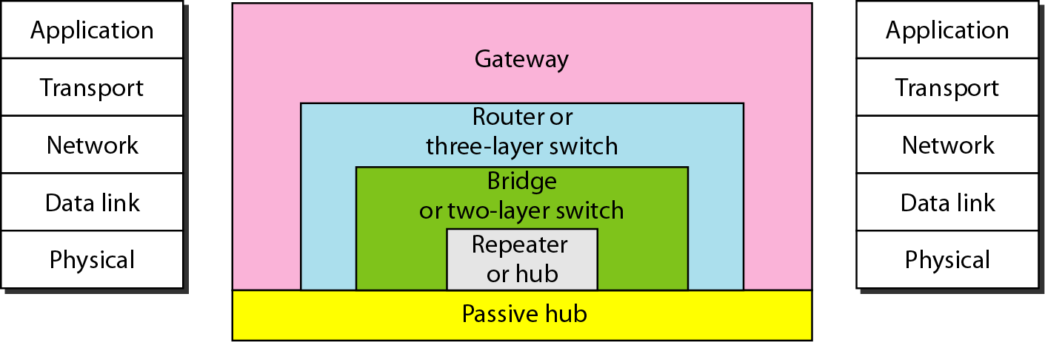
Figure 15.1 Five categories of connecting devices

Slide 5
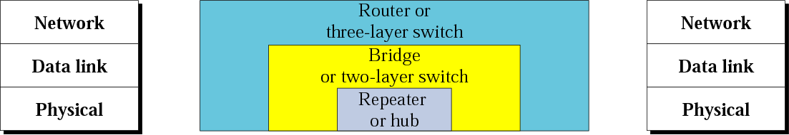
Figure 3.28 Connecting devices

Slide 6
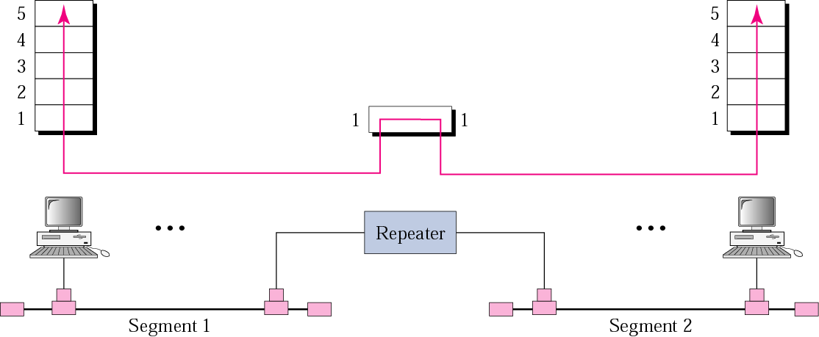
Figure 3.29 Repeater

Slide 7

Note:
A repeater connects segments of a LAN.

Slide 8
Note:
A repeater forwards every bit;
it has no filtering capability.

Slide 9
Note:
A repeater is a regenerator, not an amplifier.

Slide 10
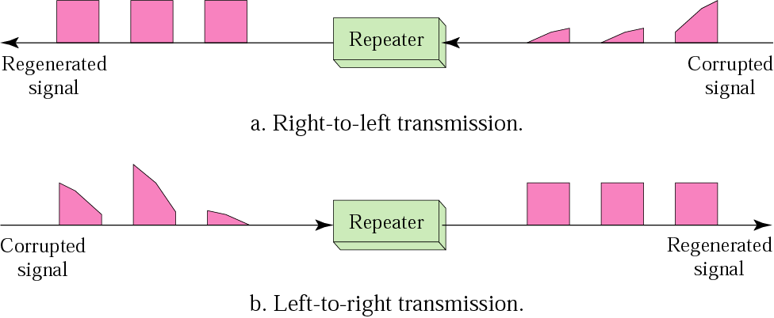
Figure 3.30 Function of a repeater

Slide 11
Note:
A bridge has a table used in filtering decisions.

Slide 12
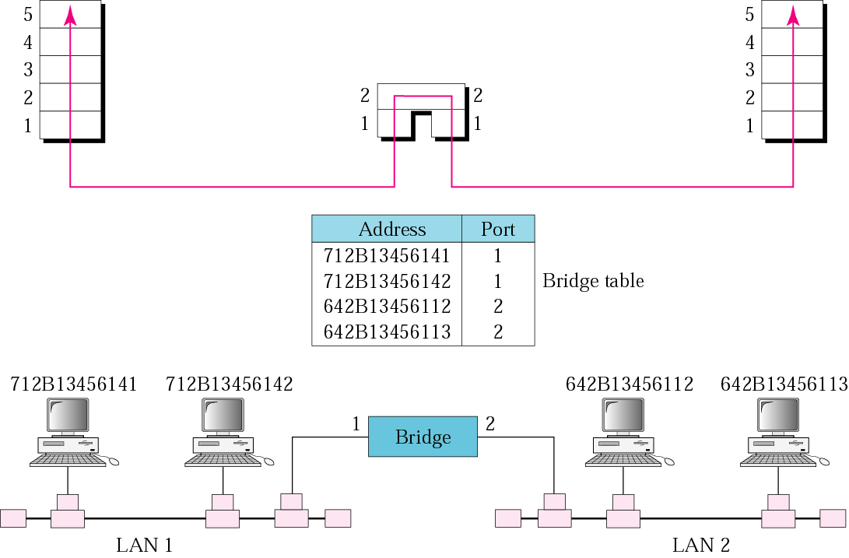
Figure 3.31 Bridge

Slide 13
Note:
A bridge does not change the physical (MAC) addresses in a frame.

Slide 14
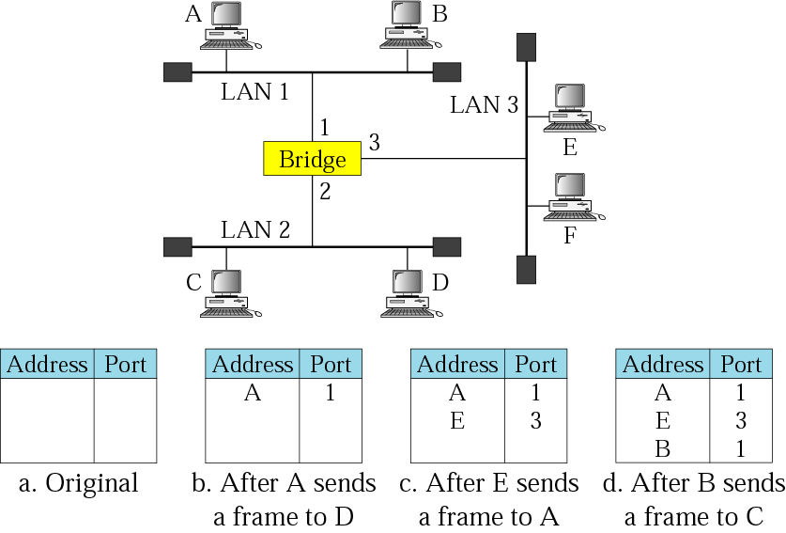
Figure 3.32 Learning bridge

Slide 15
Note:
A router is a three-layer
(physical, data link, and network)
device.

Slide 16
Note:
A repeater or a bridge connects segments of a LAN.
A router connects independent LANs or WANs to create an internetwork (internet).

Slide 17
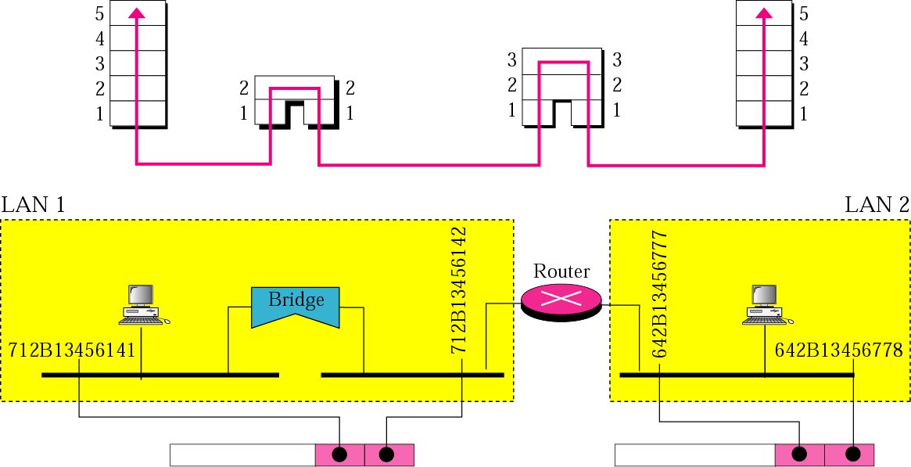
Figure 3.33 Routing example

Slide 18
Note:
A router changes the physical addresses
in a packet.

